Slide 1
Secured data hiding in images by using stegnography
CAPSTONE PROJECT
Presented By: KADUMURU PARTHASARADHI
Student Name: KADUMURU PARTHASARADHI
College Name & Department : RAYALASEEMA UNIVERSITY COLLEGE
OF ENGINEERING

Slide 2
OUTLINE
Problem Statement
Technology used
Wow factor
End users
Result
Conclusion
Git-hub Link
Future scope

Slide 3
Problem Statement
Problem Statement: Secured Data Hiding in Images Using Steganography
With the increasing need for secure communication and data protection, the challenge of safeguarding sensitive information in a digital world has become more crucial. One of the key techniques for ensuring privacy and security in data transmission is steganography, which involves embedding hidden data within an innocent-looking cover medium (such as an image) to prevent unauthorized access. However, ensuring the security of the hidden data while maintaining the quality of the cover image presents several challenges.
Problem Statement: The problem lies in designing an efficient and secure steganography system for hiding sensitive data within images, where the primary goals are to ensure that:
The hidden data remains undetectable to unauthorized users, i.e., the stego-image should appear as similar as possible to the original cover image.
The hidden data can be securely extracted by authorized recipients without being compromised or altered.
The quality of the cover image (including visual and structural integrity) should not be significantly impacted by the embedding process.
Key Challenges:
Invisible Data Embedding: Ensuring that the hidden data does not cause perceptible changes to the image, making it detectable to human eyes or image analysis techniques.
Data Integrity and Recovery: Guaranteeing that the data can be accurately extracted without any loss or corruption, even when the image is subjected to common image-processing operations (compression, resizing, etc.).
Security: Protecting the embedded data against unauthorized extraction, ensuring that only legitimate parties can retrieve the hidden information.

Slide 4
Technology used
An operating system of windows 11
System requirements :
4gb ram
Good internet connection
Installation of python software along with libraries
Good storage space

Slide 5
Wow factors
Unique Features of Secured Data Hiding in Images Using Steganography
The process of hiding data securely within images through steganography incorporates several unique features that enhance its effectiveness, confidentiality, and robustness. Here are some of the key distinctive features:
1. Invisible Data Embedding (Imperceptibility)
Subtle Alterations: The primary feature of a secure image-based steganography system is that the embedded data is invisible to the human eye. The image should appear indistinguishable from the original cover image even after the data has been hidden within it.
Minimal Distortion: Advanced algorithms are used to ensure that any changes made to the image during embedding are imperceptible, ensuring that the quality of the image is not degraded, and the hidden data remains secret.
2. Capacity and Compression Optimization
High Data Capacity: A robust steganographic system aims to hide large amounts of data within an image without significantly impacting the visual quality. Some advanced methods make use of techniques like adaptive data embedding, where more data can be hidden based on image complexity.
Efficient Compression Handling: Ensuring that the hidden data survives standard compression techniques (like JPEG or PNG compression) is a unique feature of advanced steganography methods. Some systems also adapt the embedding process to allow the image to be compressed without losing the embedded information.
3. Encryption of Hidden Data
Data Encryption: The hidden data itself is often encrypted before embedding, adding an additional layer of security. Even if an attacker detects the presence of hidden data, encryption ensures they cannot access or interpret the information without the decryption key.
Two-Layer Security: The combination of steganography (hiding the data) and encryption (securing the data) provides a double layer of protection, making it more challenging for adversaries to compromise the hidden information.
4. Robustness Against Attacks
Resistance to Image Manipulations: Advanced steganographic techniques are designed to be resilient to various types of image manipulations, such as resizing, rotation, cropping, and compression. The data should remain intact and extractable even if the image undergoes normal transformations.
Error Detection & Correction: Some systems use error-correction codes to ensure that even if part of the image is damaged or corrupted, the embedded data can still be retrieved with high accuracy.

Slide 6
WOW FACTORS
5. Adaptive and Context-Aware Embedding
Context-Aware Embedding: Some techniques embed data in areas of the image that are least likely to be noticed (e.g., in regions of low texture or in the least significant bits of pixels). This adaptiveness to the image content ensures that the hidden data doesn’t disrupt the image's appearance.
Selective Embedding: Embedding data can be optimized by selecting only specific regions in an image (such as the least sensitive or most stable parts), thereby enhancing imperceptibility and reducing the chance of detection.
6. Digital Watermarking and Authentication
Watermarking: Some systems integrate watermarking features with steganography, ensuring that the integrity of the image can be verified while also hiding data. This can be useful in contexts where the authenticity of the image is important (e.g., for copyright protection).
Authentication Mechanism: Using a secure key, the stego-image can be verified to ensure that it hasn't been tampered with, allowing recipients to confirm both the integrity of the hidden data and the authenticity of the image itself.
7. Low Computational Overhead
Efficient Algorithms: Modern techniques aim to keep the computational load low while hiding data, which is especially important in applications requiring real-time performance, such as live video streaming or mobile communication.
Scalability: The technique should be scalable for images of different sizes and resolutions, making it adaptable for a wide range of applications, from low-resolution images to high-definition media.
8. User-Friendly Interface and Practical Applications
Ease of Use: The systems should provide user-friendly interfaces, allowing both technical and non-technical users to hide and extract data with ease, without needing a deep understanding of the underlying algorithms.
Practical Applications: Secure data hiding can be applied in various domains such as confidential communication, digital forensics, protection of intellectual property, and secure file sharing, where privacy is critical.
9. Multiple Data Types Support
Diverse Data Hiding: Some steganographic systems allow hiding not just textual data but also other types of data, such as audio files, video, or even small executable programs, within the image. This feature increases the versatility of the method.

Slide 7
End users
The technology of secured data hiding in images using steganography serves a wide range of end users across different sectors. Here’s an overview of the potential end users who benefit from this technology:
1. Government and Intelligence Agencies
Use Case: Secure communication and data transfer.
Benefit: Governments and intelligence agencies use steganography to securely exchange sensitive information, such as intelligence reports, covert communications, or national security data. The technique allows for the hiding of messages in images, making them difficult to detect and intercept by adversaries.
2. Military
Use Case: Covert operations and secure transmission of critical data.
Benefit: Military personnel utilize steganography to hide secret messages within images for operations in conflict zones. The hidden data can be critical mission information, orders, or coordinates, sent in a way that is unlikely to be detected by enemies or cyber attackers.
3. Corporate Entities (Enterprises)
Use Case: Secure communication and intellectual property protection.
Benefit: Corporations may use steganography to protect intellectual property, such as proprietary documents, designs, and trade secrets, by embedding them into images for secure transfer. This helps protect confidential business data from being intercepted or accessed by competitors or cybercriminals.
4. Digital Forensics and Cybersecurity Professionals
Use Case: Detecting and preventing cyberattacks, digital evidence analysis.
Benefit: Cybersecurity experts may use steganography to securely share critical evidence of cybercrime or malicious activity, while forensic investigators can use it to hide and preserve digital evidence in image files that need to be transported discreetly without risk of exposure or tampering.
5. Journalists and Whistleblowers
Use Case: Safeguarding confidential information and secure whistleblowing.
Benefit: Journalists and whistleblowers who need to protect their sources and sensitive documents from government or corporate scrutiny can use steganography to transmit confidential information securely, ensuring that the data remains hidden from unauthorized surveillance or detection.

Slide 8
END USERS
6. Academics and Researchers
Use Case: Secure exchange of sensitive research data.
Benefit: Researchers dealing with sensitive data (e.g., medical research, proprietary scientific findings) can use steganography to protect intellectual property or maintain confidentiality when sharing results across digital platforms.
7. Cryptographers and Security Engineers
Use Case: Enhancing cryptographic protocols with hidden data.
Benefit: Cryptographers and security engineers may combine steganography with encryption techniques to develop multi-layer security systems for embedding and protecting confidential information during transmission or storage. It ensures that even if one layer of security is breached, the data remains protected.
8. Content Creators and Artists
Use Case: Protecting digital art and media files.
Benefit: Artists and content creators can embed hidden copyright information or watermark their work within images to assert ownership and prevent unauthorized distribution. The hidden data helps to authenticate the creator’s rights without visibly altering the artwork.
9. Privacy-conscious Individuals
Use Case: Personal data security and secure messaging.
Benefit: Individuals who are highly concerned about their privacy, including journalists, activists, or citizens living under authoritarian regimes, may use steganography to protect personal data or send private messages through seemingly innocuous images to avoid surveillance or censorship.
10. Healthcare and Medical Industry
Use Case: Secure transmission of patient data.
Benefit: Healthcare providers can use steganography to securely transmit sensitive medical data, such as patient records, test results, or medical images (X-rays, MRIs) while maintaining privacy and adhering to regulations like HIPAA (Health Insurance Portability and Accountability Act).

Slide 9
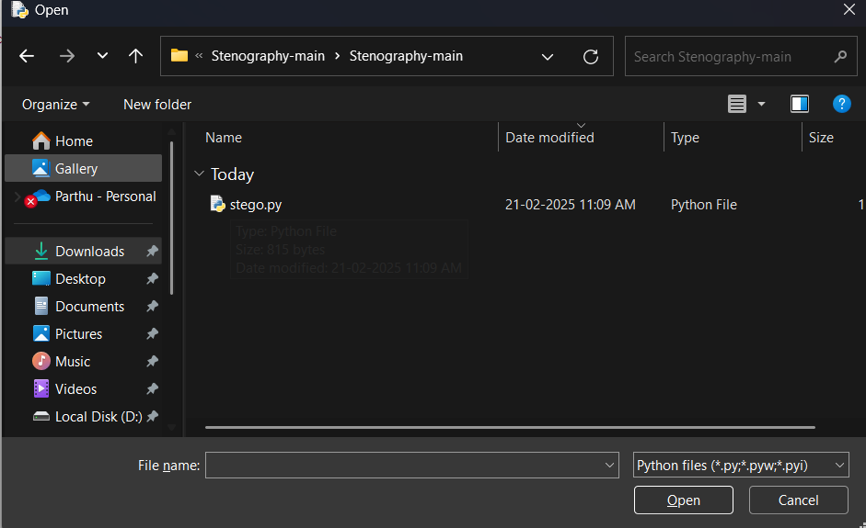
Results

Slide 10


Slide 11
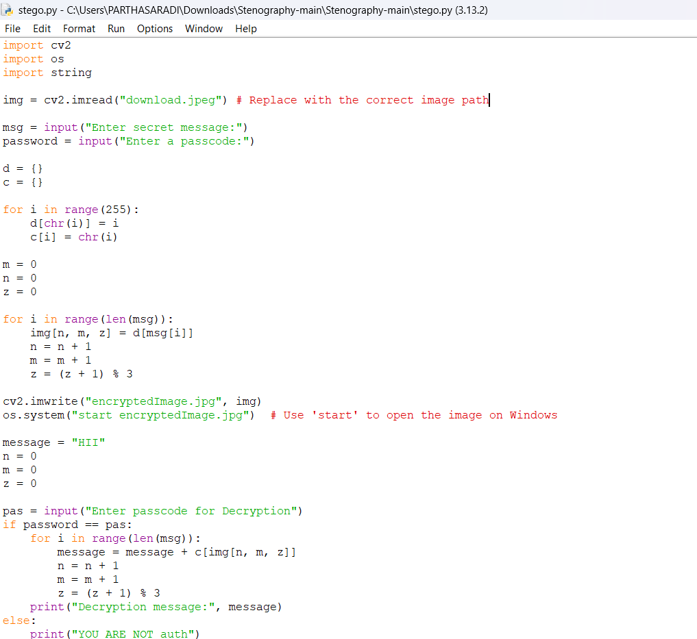

Slide 12
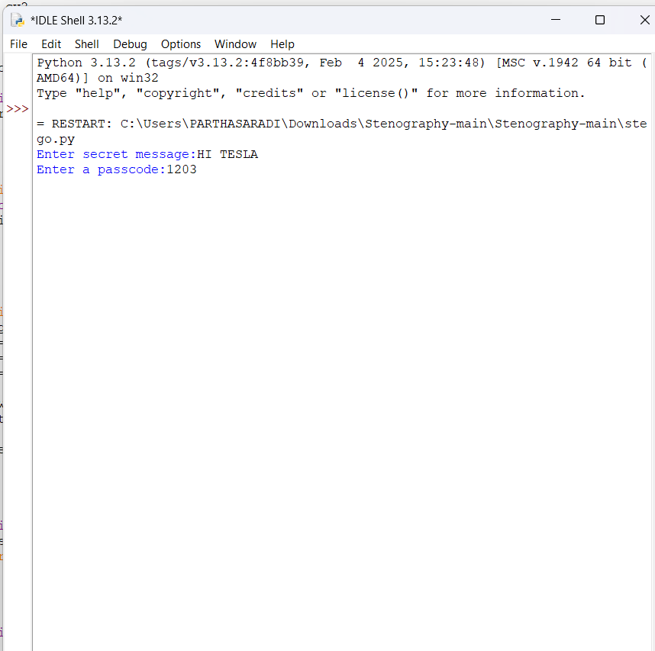

Slide 13


Slide 14
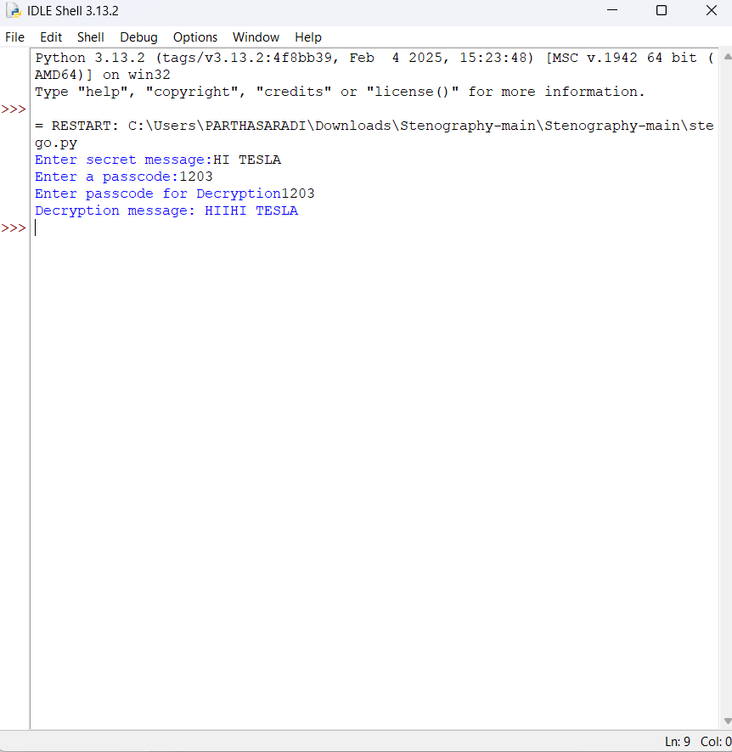

Slide 15
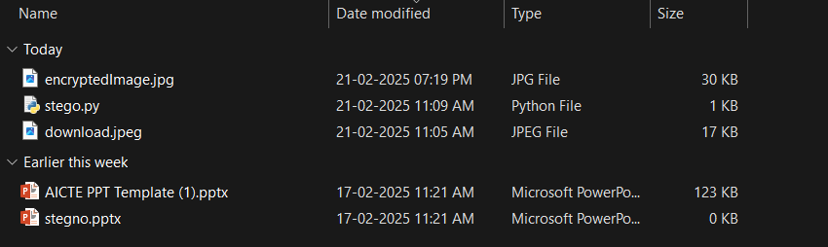
RESULT:

Slide 16
Conclusion
Secured data hiding in images using steganography is a powerful technique that combines privacy, security, and innovation to protect sensitive information. It offers a unique approach for embedding data into an image in a way that is imperceptible to the human eye, making it an ideal solution for secure communication and data protection across various sectors. Whether for government agencies, military operations, corporate environments, or individuals, the ability to hide critical data within seemingly innocent images has proven invaluable.
Key benefits of steganography include:
Imperceptibility: The data remains hidden without affecting the image's appearance, ensuring that unauthorized users cannot easily detect its presence.
Security: By combining encryption with steganographic techniques, the hidden data is further protected from prying eyes.
Robustness: Advanced algorithms offer resilience against common image manipulations, such as compression and resizing, ensuring the hidden information remains intact.
Wide Applications: From digital forensics and intellectual property protection to secure communications for journalists and activists, steganography in images serves a broad range of end users who require confidentiality and data integrity.

Slide 17
GitHub Link
Make sure that there should be readme file

Slide 18
THANK YOU

